Slide 1


1 Project Presentation (KCS 753) (Adaptive Online Platform For Enhanced Teaching and Learning)
KIET Group of Institutions, Ghaziabad
(An ISO – 9001: 2008 Certified & ‘A+’ Grade accredited Institution by NAAC)
Guide Name: Dr. Gaurav Dubey
Project Members Name with Roll Number & Section
1. Amod Katiyar (2000290120022) (Sec-A)
2. Himanshu Kumar (2000290120076) (Sec-B)
3. Aniket Bhardwaj (2000290120024) (Sec-A)

Slide 2
Problem Statement
Despite the fact that there are many options and that everything is so diverse, students find it difficult to learn. Nothing can ever be found on a single platform. We intend to resolve this issue
The numerous possibilities that a student faces when deciding on a Specific domain to work in, the numerous questions that arise in his mind as to whether this is suitable for me or not, whether it will help me land a job in an MNC or not.
Even after deciding on a domain, the next question is how to get there, how to get started, and how to properly learn each and every concept
How to practice and revise concepts to achieve the best results. Instead of spending hours researching which courses to take and which channels to follow on the internet, our platform has already done all of the legwork for you, saving you a lot of time. Furthermore, all of that content will be available in a single location.

Slide 3
Objectives
Our goal is to address the issues that students face on a daily basis, which may not seem significant at first but can be extremely harmful in the long run. Choosing a domain that does not excite you or is not of your interest and devoting time to it will result in time wasted
It is pointless to learn essentially extinct technologies that have been replaced by newer and more advanced technologies. knowing the current industry trend and selecting a domain based on it will prove fruitful to you.
Following a dedicated roadmap to learn the respective languages will assist students in learning the fundamental concepts and thereby strengthening their foundation. Learning the concepts in the prescribed order ensures that no important topics are overlooked and that the student has a thorough understanding of each and every topic.

Slide 4
Technology Used
The platform's development has been divided into two parts: frontend and backend. The frontend will be built with HTML and CSS, where HTML will provide the basic framework for the website and CSS will be used for styling. The goal is to create an easy-to-use website that is user-friendly and easy to navigate.
The backend will be built with React, Express, and Node JS, as well as JavaScript. React and JavaScript will provide functionality to the website, as well as the necessary post and get requests. MongoDB will be used to create a database that will store the students' information as well as their current progress. React will also be used to improve the overall interface of the website, which when combined with the backend will result in the perfect website.
Machine learning techniques are used in the industry to implement real-time language usage. the rate at which the particular language is growing and the language's future trends. The domains that are currently required in the industry, as well as the average salary trends for jobs in the respective domain.

Slide 5
Literature Survey
Title: A review and analysis of technologies for developing web applications
Author: BY-SOLOMON ANTONY
Year of publishing: March 2012
Object oriented approach build web applications very efficient when one can accomplish more in less time. Because it uses modern processes, by this both developers and clients can benefit. To develop these types of applications there are so many scripting languages and new technologies are there we don’t have to stick to one. It gives 14 good knowledge to the developers as well as clients in choosing of web application platform.

Slide 6
Literature Survey
Title: Web Application Development -a study on UML Web Application Extension
Author: Andreas Oskarsson, Martin Kling, Tobias Norberg
Year of publishing: March 2012
The use of UML for Web application development will result in good design, regarding to maintainability. Extensibility was supported through low coupling, high cohesion and the possibility to create generalization/specialization hierarchies. Reusability was supported by the ability to apply white-box reuse. This thesis was unable to resolve whether UML WAE supports black-box reuse. The produced documentation was understandable, easy to read and had highly traceable diagrams. With our three criteria extensibility, reusability and documentation examined and found to be in support, the conclusion is that the use of UML for Web application development resulted in good design regarding to maintainability

Slide 7
Literature Survey
Title: Research on HTML5 in Web Development
Author: Ch Rajesh,K S V Krishna Srikanth
Year of publishing: 2014
HTML5 introduces new elements and features that allow developers to improve interoperability, handling elements in a precise way saving time and costs. HTML5 is an awesome technology and has the possibility to make the web even more predominant and extensive as it is today from desktop computers to mobile devices and in the future maybe even domestics appliances. The potential of HTML5 will soften the line between desktop and online applications. The problem HTML5 may suffer in the coming days is that an opportunity will be available for the malware writers which may make today's common hacks.

Slide 8
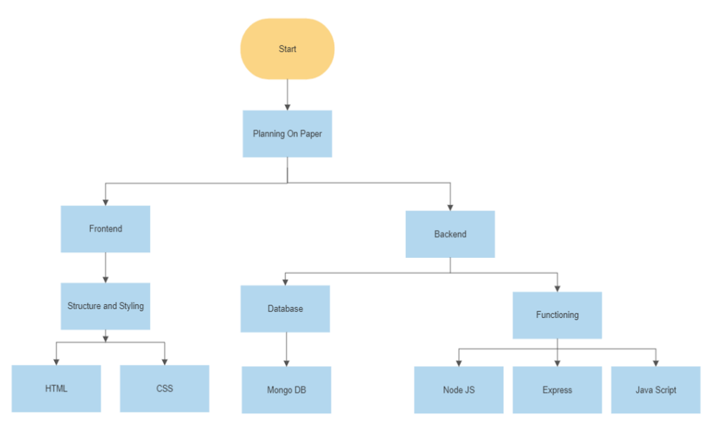
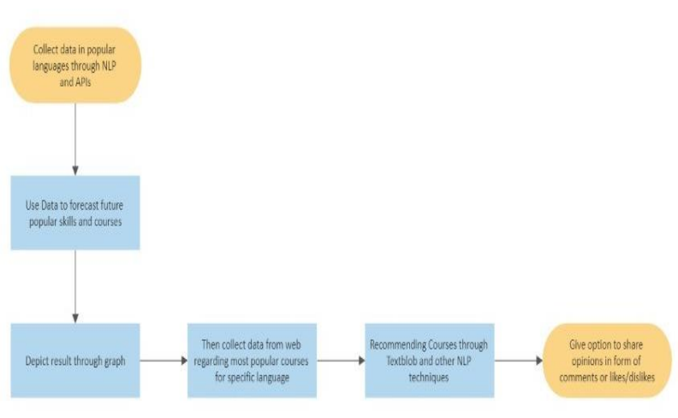
Workflow Diagram

Slide 9
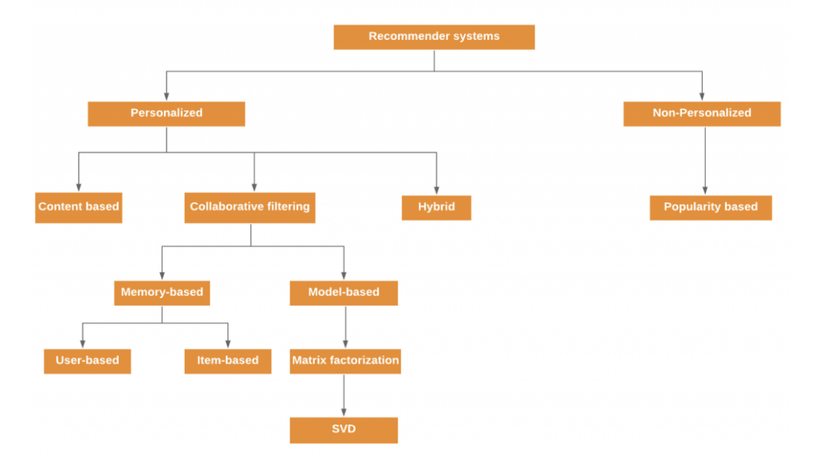
Workflow Diagram

Slide 10
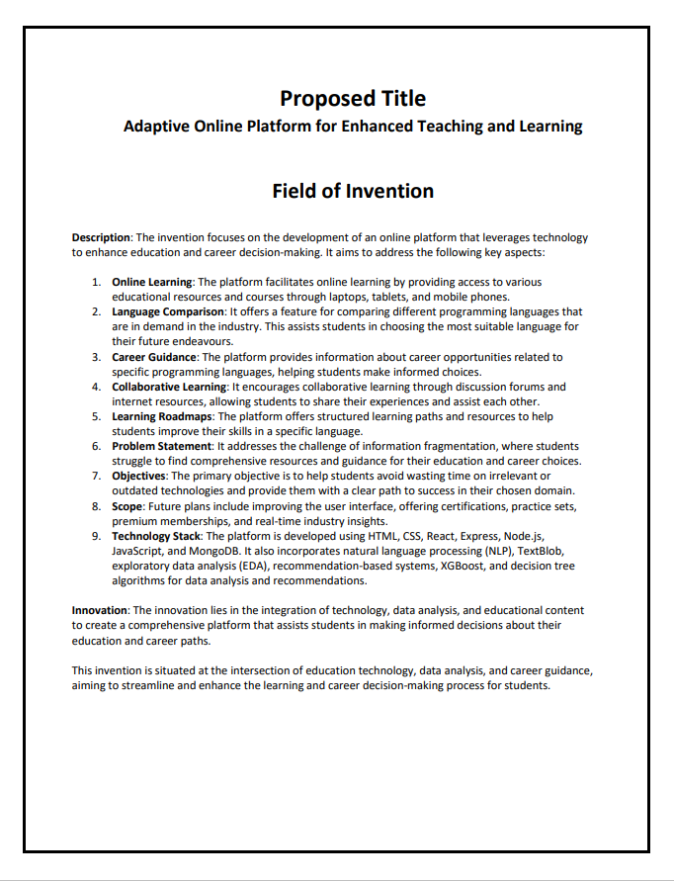
Patent Status
Submitted

Slide 11
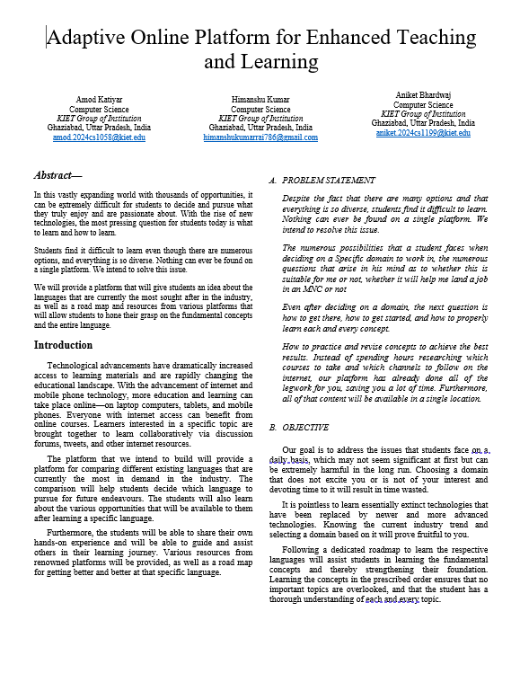
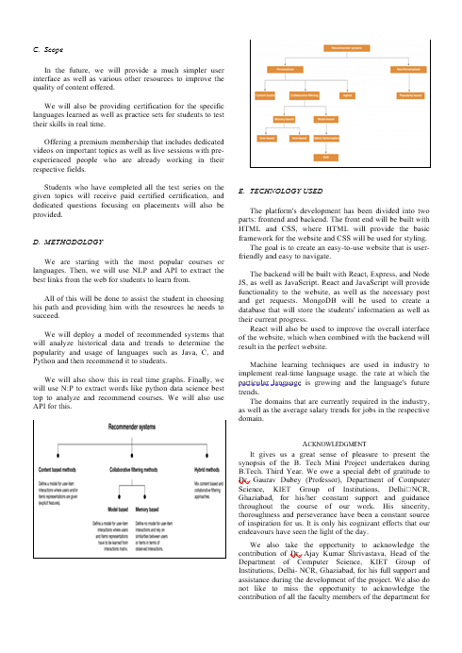
Research Paper Status
Working on Research Paper.

Slide 12
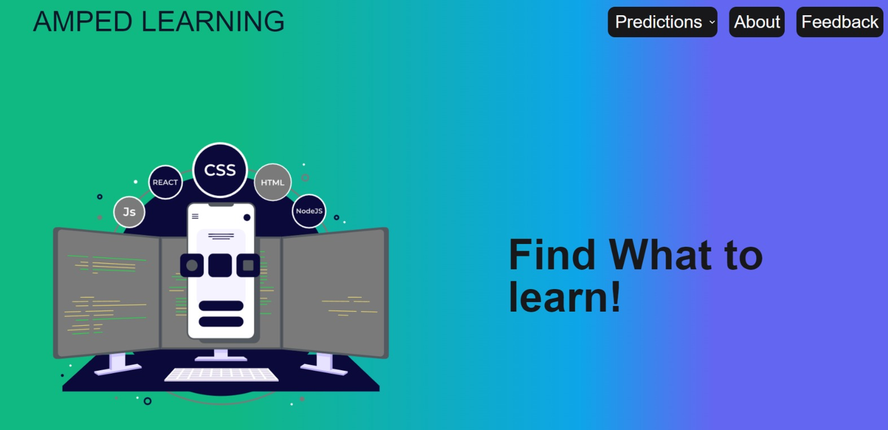
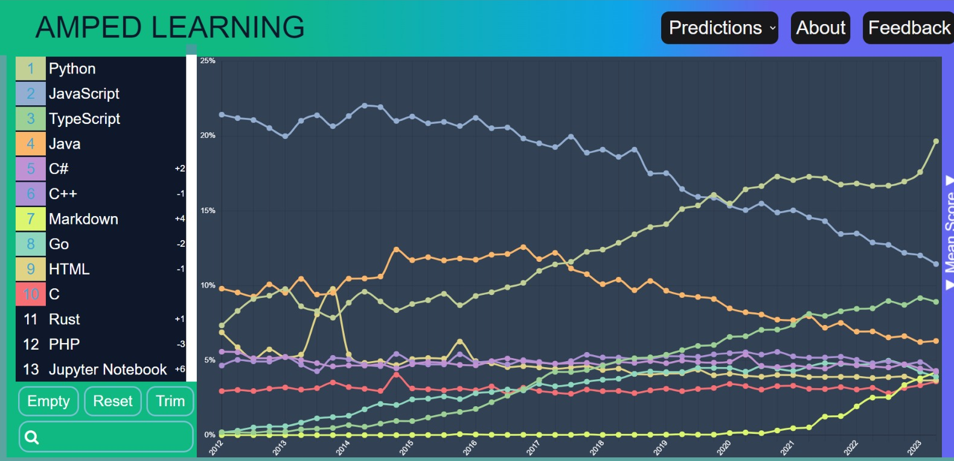
Project Status

Slide 13
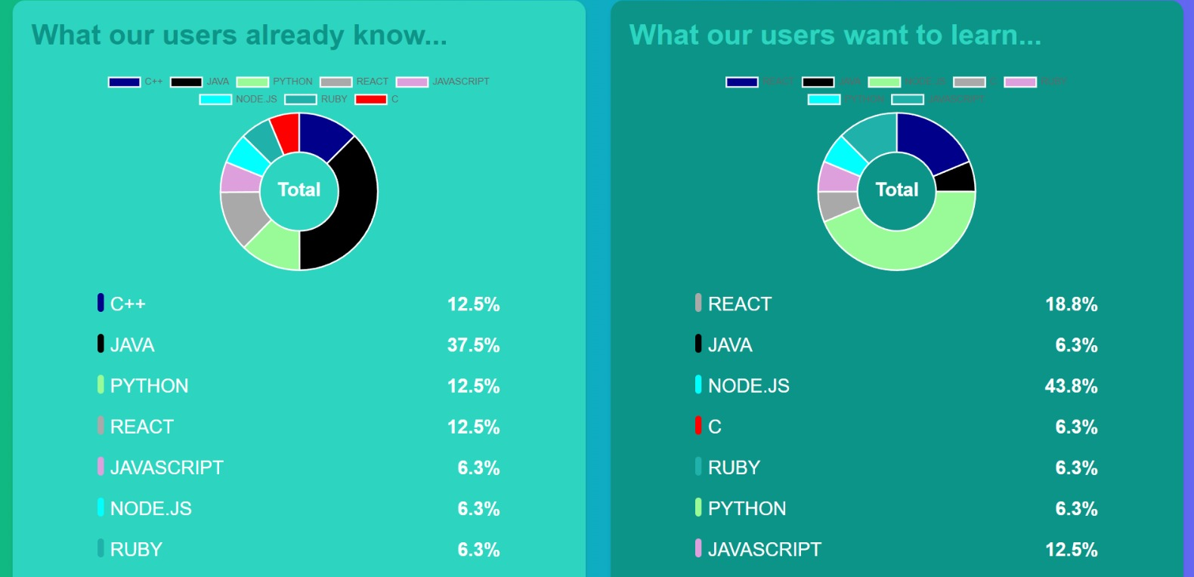
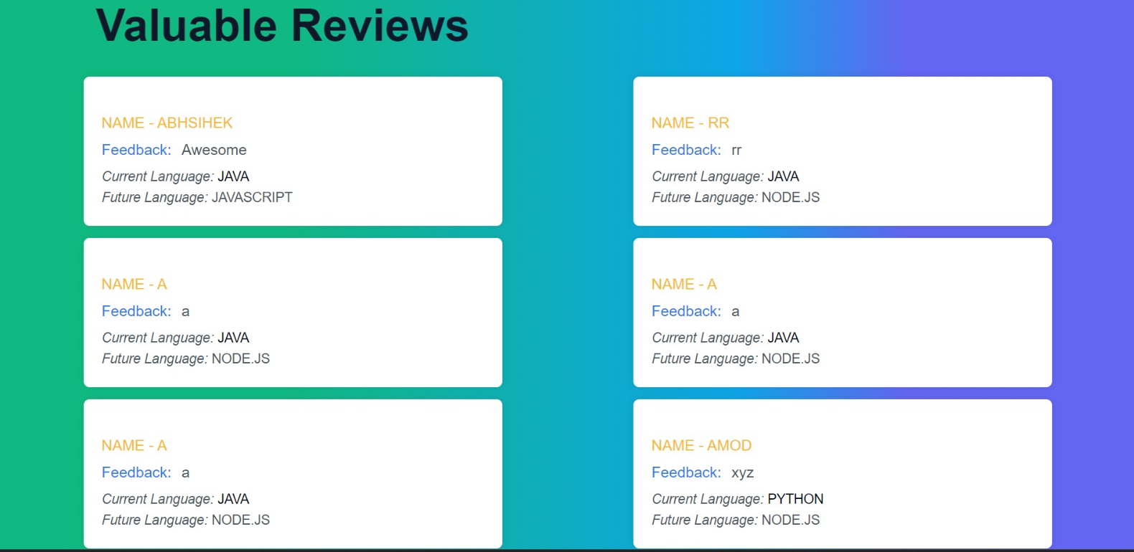
Project Status

Slide 14
References
[1] A review and analysis of technologies for developing web applications, BY-SOLOMON ANTONY
[2] Web Application Development -a study on UML Web Application Extension, Andreas Oskarsson, Martin Kling, Tobias Norberg
[3] Research on HTML5 in Web Development, Ch Rajesh, K S V Krishna Srikanth
[4] www.stackoverflow.com

